Slide 1
TLS Handshake Protocol
Yamini Buyya
Student ID: 801482615
Principles of Information Security (PISP)

Slide 2
WHY THIS PROJECT?
THE PROBLEM : How do two parties communicate securely over an insecure network when they've never met?
THE SOLUTION: TLS Handshake Protocol
REAL-WORLD APPLICATIONS:
  HTTPS websites (billions daily) ,Online banking, Email encryption ,VPN connections
PROJECT GOAL :
  Build TLS from scratch to understand
  How authentication works (RSA)
  How key exchange works (Diffie-Hellman)
  How encryption secures data

Slide 3
THREE LAYER ARCHITECTURE
LAYER 3: PROTOCOL LOGIC
TLSClient, TLSServer TLSMessage, HandshakeState
LAYER 2: CRYPTOGRAPHIC ALGORITHMS:RSA (Authentication), Diffie Hellman (Key Exchange), KDF(Key Derivation)
LAYER 1: MATHEMATICAL PRIMITIVES MathUtils (Modular arithmetic, Prime generation), ByteUtils

Slide 4

Layer 1 Mathematical Foundation
MathUtils - BUILDING BLOCKS
MODULAR EXPONENTIATION ALGORITHM:
  Repeated Squaring Function: modPow(base, exp, mod)
  Example: 3^13 mod 7 = 3
  Complexity: O(log n) instead of O(n)
PRIME NUMBER GENERATION ALGORITHM : Miller-Rabin Primality Test
  Function: isProbablePrime(n, iterations) the Accuracy: 99.9999% with 10 iterations
  Usage: Generate RSA primes (p, q)
MODULAR INVERSE ALGORITHM : Extended Euclidean Algorithm
  Function: modInverse(a, m)
  Purpose: Compute RSA private key d
WHY THESE MATTER
  All of RSA and DH depend on these operations!

Slide 5

Layer 2-Part A
RSA Authentication
RSA - SERVER AUTHENTICATION
RSA KEY GENERATION
  1. Generate two primes: p, q
  2. Compute n = p × q
  3. Compute φ(n) = (p-1)(q-1)
  4. Choose e = 65537
  5. Compute d = e⁻¹ mod φ(n)
  Public Key: (e, n) → Send to client
  Private Key: (d, n) → Keep secret
WHY RSA?
  Proves server identity , Public key can be shared safely , Security based on factoring difficulty
SECURITY
  Factoring 2048-bit: Millions of years

Slide 6
Layer 2-Part B
Diffie-Hellman Key Exchange
DIFFIE HELLMAN- SECURE KEY EXCHANGE
THE MAGIC OF DIFFIE-HELLMAN
  Public Parameters (known to everyone)
  p = large prime
  g = generator
SERVER: server_private = random, server_public = g^server_private mod p
CLIENT: client_private = random,client_public = g^client_private mod p
  Exchange public keys over network
SERVER SECRET = client_public^server_private mod p
CLIENT SECRET= server_public^client_private mod p
  SAME SECRET! But Eve can't compute it!
PERFECT FORWARD SECRECY
  New DH keys each session → Past sessions secure

Slide 7
Layer 2-Part C
Key Derivation
KDF - SESSION KEY DERIVATION
WHY KEY DERIVATION? Can't use DH shared secret directly!
Problems with direct use:
  Wrong format (BigInteger, not bytes)
  Need TWO keys (encryption + MAC)
  Vulnerable to brute force
SOLUTION: KDF (Key Derivation Function)
  shared_secret
  ↓
  [Hash 10,000 times]
  ↓
  master_key (32 bytes)
  ↓
  Split into two keys: encryption_key (16 bytes) ,MAC_key (16 bytes)
BENEFITS:
  Proper format for encryption
  Separate keys (security best practice)
  10,000 iterations slow down brute force

Slide 8

Layer 3 - Protocol Implementation
PROTOCOL LAYER - MESSAGE HANDLING
TLSMessage
  Defines 7 message types
  Binary format: [Type][Length][Payload]
  Serialization for network transmission
HandshakeState -State machine (9 states)
  Tracks handshake progress
  Stores cryptographic materials
  Validates message order
State Flow
IDLE → CLIENT_HELLO_SENT → SERVER_HELLO_RECEIVED → SERVER_CERT_RECEIVED → CLIENT_KEY_EXCHANGE_SENT → FINISHED_SENT → FINISHED_RECEIVED → HANDSHAKE_COMPLETE
WHY STATE MACHINE?
  Security! Prevents out-of-order or replay attacks

Slide 9

The Complete TLS Handshake
6 PHASES OF TLS HANDSHAKE
Phase 1: SERVER INITIALIZATION
  Server generates RSA key pair
Phase 2: CLIENT HELLO
  Client → [CLIENT_HELLO + 32-byte random] → Server
Phase 3: SERVER HELLO + CERTIFICATE
  Server → [SERVER_HELLO + 32-byte random]
  Server → [CERTIFICATE with RSA pub + DH params]
Phase 4: CLIENT KEY EXCHANGE
  Client generates DH keys, computes shared secret
  Client → [CLIENT_KEY_EXCHANGE + DH public]
Phase 5: FINALIZING HANDSHAKE
  Server computes shared secret, both derive keys
  Server → [FINISHED (encrypted with session key)]
  Client → [FINISHED (encrypted with session key)]
Phase 6: ENCRYPTED COMMUNICATION
  Bidirectional encrypted data exchange

Slide 10
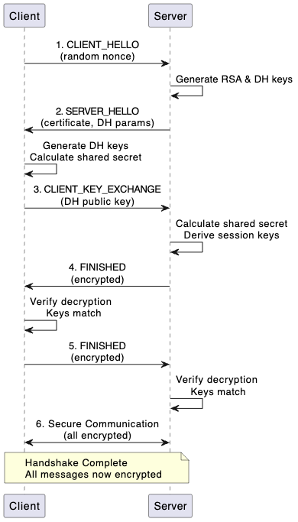
Sequence Diagram

Slide 11
Code Flow
Main.java - DEMONSTRATION APPLICATION
public static void main(String[] args) {
TLSClient client = new TLSClient();
TLSServer server = new TLSServer();
// Phase 1: Server setup
server.initialize();
// Phase 2: Client hello
TLSMessage hello = client.sendClientHello();
// Phase 3: Server response
TLSMessage[] response = server.handleClientHello(hello);
// Phase 4: Client key exchange
client.handleServerMessages(response);
TLSMessage keyEx = client.sendKeyExchange();
// Phase 5: Finalization
TLSMessage sFinish = server.handleKeyExchange(keyEx);
TLSMessage cFinish = client.handleFinished(sFinish);
server.handleFinished(cFinish);
// Phase 6: Encrypted communication
demonstrateEncryptedComm(client, server);

Slide 12
Security Analysis
SECURITY PROPERTIES ACHIEVED
CONFIDENTIALITY
  All data encrypted with session keys
  Keys derived from shared secret
  Eavesdropper sees only ciphertext
AUTHENTICATION
  Server proved identity via RSA public key
  Client verifies server has matching private key
PERFECT FORWARD SECRECY
  Ephemeral DH keys (new each session)
  Keys exist only in RAM during session
  Compromising RSA key doesn't expose past data
REPLAY PROTECTION
  Client random: 32 bytes
  Server random: 32 bytes
  Session ID: Unique per connection
  Each session cryptographically unique

Slide 13
Conclusion
IMPLEMENTED FROM SCRATCH
  Modular exponentiation (repeated squaring)
  Miller-Rabin primality test
  Complete RSA (key gen, encrypt, decrypt)
  Complete Diffie-Hellman key exchange
  Key derivation function
  TLS protocol with state machine
REAL-WORLD RELEVANCE
  This is how HTTPS, VPNs, SSH, and secure communications work! Billions of TLS handshakes happen every day securing the internet.

Slide 14
Thank you
Questions?

